Slide 1



EVALUATION OF THE IMPLEMENTATION OF 2014-2020 ENVIRONMENTAL PROTECTION MEASURES

Slide 2
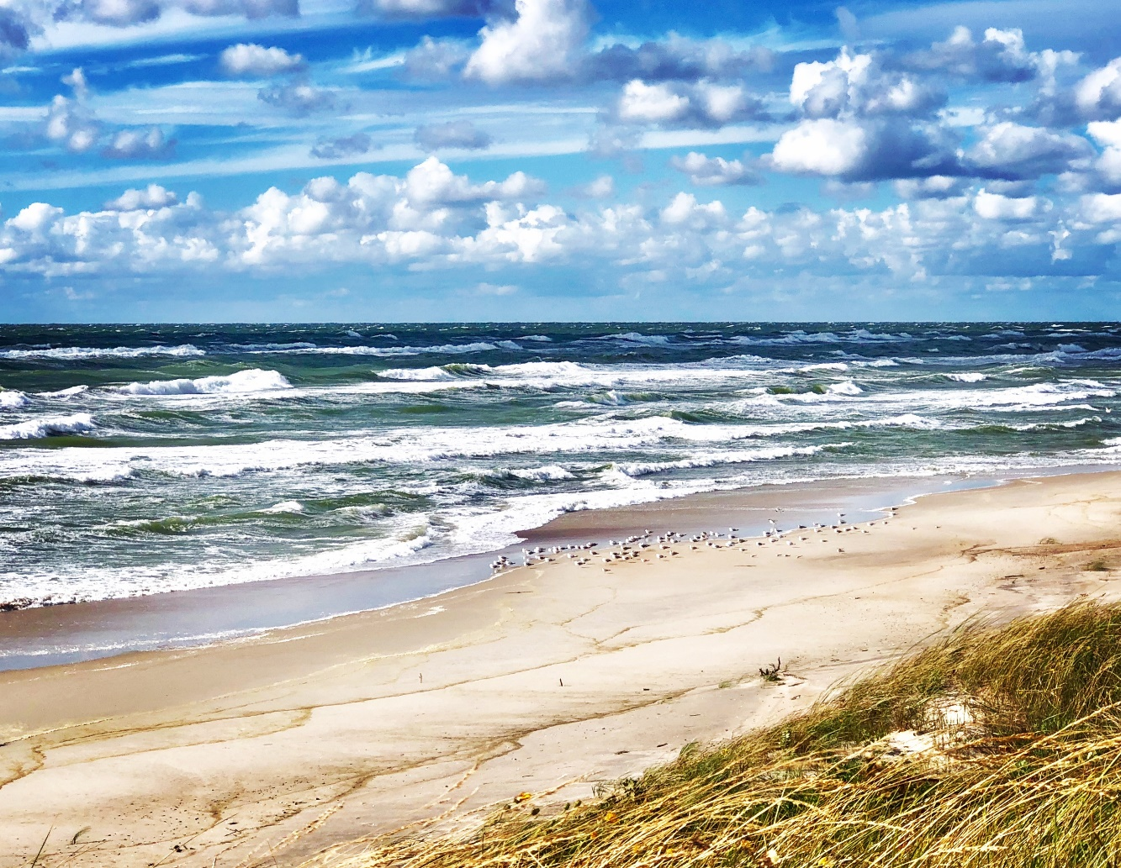
The object of the evaluation
The evaluation focuses on specific environmental measures financed from the EU Structural Funds in the programming periods of 2007-2013 and 2014-2020
Over the two programming periods more than EUR 550 million was allocated for the investments and communication measures implemented in the field of environmental protection in Lithuania

Slide 3
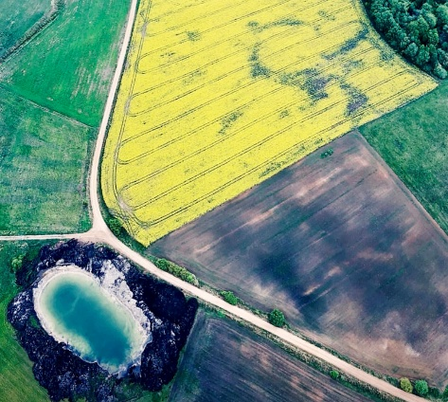
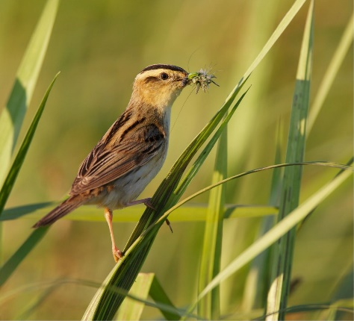

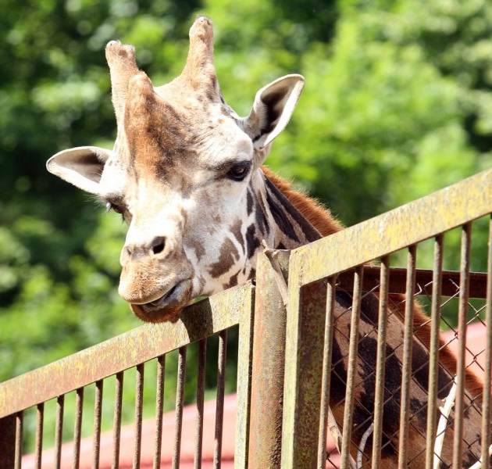


Which environmental protection areas were funded by the EU Structural Funds Investments?*
adaptation to climate change: €186,6 M
Biodiversity and landscape protection: €177,4 M
improvement of ground and surface water resources: €103,6 M
ENVIRONmental information and improvement of environmental-recreational objects: €42,4 M
Management of contaminated sites: €34 M
reducing of air pollution:
€7,3 M
* The funds of both programming peropds.

Slide 4
Goal and objectives of the evaluation
1st objective: to asses the impact and sustainability of environmental measures funded in the period of 2007-2013
2nd objective: to asses the relevance, effectiveness, efficiency, impact and sustainability of environmental measures funded from the OP for the 2014-2020
Results: Recommendations regarding the EU Structural Funds Investments for environmental protection in this programming period and after 2020.
Evaluation goal – to improve implementation of environmental protection measures funded by the 2014-2020 OP for EU Structural Funds Investments and to identify implementation progress

Slide 5
How the evaluation was performed?
November-December, 2018
January-March, 2019
April-May, 2019
INCEPTION stage
INTERIM stage
Final stage
Initial analysis of the evaluation object, information gathering from the secondary sources (projects information), drafting of the Inception Report.
Interviews, desk research, data analysis and drafting of the Interim Report.
Drafting of Final Report
The main unit of analysis was the OP measure. All in all, it was evaluated 9 measures from the 2007-2013 programming period and 12 from the 2014-2020 period.
By doing this evaluation, first time in Lithuania it was tried to estimate efficiency of environmental measures by using cost-benefit analysis and ecosystem services.
The Theory of Change approach was applied in order to explain how much and why the environmental changes in the period 2007-2017 were caused by the EU funds investments.

Slide 6
What are the main conclusions of the evaluation?
Since 2007 Lithuania made a huge progress in implementing EU directives requirements in such areas as improvement of water resources, implementation of rivers basins district management plans, protection of nature or biodiversity and expansion of Natura 2000 territories. All evaluated measures directly contribute to the implementation of the objectives of environment protection policy set in the National Environmental Protection Strategy.
Because of constantly changing environment status, it is difficult to ensure sustainability of completed investments. For this reason, as well as the returning EU environmental requirements, continued funding is needed in all areas examined. However, not only funding, but also the coordination of different funding instruments (especially with the Rural Development Program) and the wider application of other environmental policy measures (regulatory, economic and communication) are important.
It is given more than 30 recommendations for improving environmental measures funded by EU Structural Funds Investments.

Slide 7
Cost-benefit analysis of the measures

Slide 8

Task
2nd objective: to asses the relevance, effectiveness, efficiency, impact and sustainability of environmental measures funded from the OP for the 2014-2020
Economic (cost-benefit) analysis was carried out only for a part of projects planned for 2014-2020
The Methodology for development of investment projects, to be funded by the EU structural funds and/or state budget was taken into consideration, however, ecosystem services approach was not applied during the preparation of the projects for 2014-2020

Slide 9
Why ecosystem services?
Natural ecosystems provide to us:
Provisioning services – water, biomass, food, etc.
Regulating services – more difficult to grasp, e.g. water purification and treatment, air quality regulation, decomposition of waste, regulation of climate, preventing soil loss, maintenance of biodiversity, pollination ir t.t.
Cultural services – non-material benefits because of interaction with nature, spiritual experiences, bequest value etc.
These services are non-market, i.e. there is no price, which would signal to a society about a change in ecosystem services

Slide 10
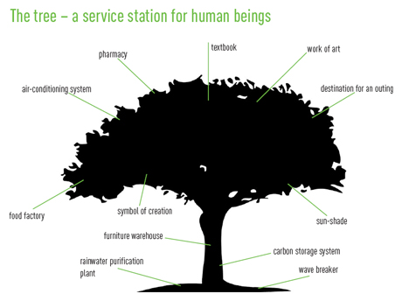
2014-2020
Measures assessed
Six thematic areas
Cost-benefit analysis of measures - simplified
Assessment of cost-benefit analysis – a small part of all tasks of the project
12 measures
Almost 200 projects
Annualised costs and benefits are assessed for all the measures, however, results could be used just for general understanding

Slide 11
Simplified analysis for the thematic area / measure
1. What kind of costs and benefits is relevant for the measure
Was cost-benefit analysis carried out?
NO
2. Analysis of costs and search for benefit valuation
YES
Are there examples about economic benefit in Lithuania?
Are there examples about economic benefit in the world?
2. Summary of the analysis carried out
NO
NO
Were economic benefit / ecosystem services valued?
YES
YES
NO
3. Adaptation of values for the thematic area / measure
3. Qualitative valuation
YES

Slide 12
Biodiversity and landscape protection
Three measures:
„Management and adapting for visiting of protected areas and state parks”
„Protection of biodiversity“
„Landscape protection“
- many valuations carried out in the EU (Natura 2000)
- taking ecosystem services into consideration may change a selected alternative
BENEFIT
Cultural heritage
Recreation and tourism
Esthetic value
Biodiversity
Prevention of climate change
TEEB (The Economics of Ecosystems and Biodiversity) database (results of more than 1300 valuation studies): recreational / esthetic and cognition value of 1 ha - from 1 to 7000 EUR.
EU-27 average value of 1 ha of „Natura 2000“ – 3440 EUR/ha.

Slide 13
Improvement of status of water resources
Two measures:
„Water resources management and protection”
„Improvement of status of water bodies“
48 per cent of water bodies in Lithuania do not meet requirements of good water status (water bodies at risk)
BENEFIT
Bio-remediation of waste, toxics and other nuisances
Hydrological cycle and water flow regulation
Cultural heritage
Recreation and tourism
Esthetic value
Biodiversity
E.g.,
One person is willing to pay 7 Eur per year for a good status of water bodies
Annual benefit - 16,6 – 74,4 million EUR/year

Slide 14
Climate change adaptation
Four measures:
„Strengthening of environmental monitoring and control”
„Management of the coastal strip“
„Flood risk management“
„Management of stormwater sewers”
While valuing benefits of management of stormwater „green“ measures are taken into consideration
Damage to ecosystem services because of „grey“ infrastructure
NAUDA
Bio-remediation of waste, toxics and other nuisances
Hydrological cycle and water flow regulation, flood risk management
Recreation and tourism
Biodiversity
Gyventojų turtas
Pvz.,
For example,
In Lithuania, recreational value of the Baltic sea equals approx. 200 million EUR/ year
Likely annual losses (damage) in the future, if floods happen in areas where projects are implemented, approx. 5 million EUR/year
Annual benefits of the good water status equal 16.6 – 74.4 million EUR/year

Slide 15
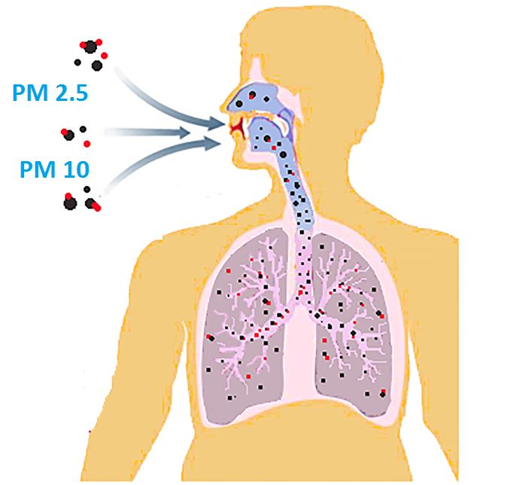
Reducing of air pollution
One measure:
„ Improvement of air quality”
Non-exhaust emissions from road vehicles make approx. half of all pollution by particulate matters by transport
,
Value, related to avoidance of premature deaths due to respiratory and cardiovascular diseases and medical costs
Willingness to pay for avoiding health risks associated with air pollution by motor vehicles in five European countries – from 100 to 155 EUR/person/year
Annual benefits associated with reduction of the PM in Lithuania equal 60 – 100 million EUR
Benefits of episodic monitoring during preparation of the air pollution reduction plans in municipalities, results of which could be added to the continuous state monitoring
BENEFIT
Air quality regulation
Human health

Slide 16
Remediation of contaminated sites
One measure:
„Management of contaminated sites”
Ecosystem services provided by soil play a crucial role in ecosystem functioning
Average investment costs of one “site” in Lithuania - 412 000 EUR, in Europe - 124 000 EUR
BENEFIT
Food
Bio-remediation of waste, toxics and other nuisances
Regulation of water flows
Regulation of erosion
Secures life cycle
Pest control
Climate regulation
For example,
Annual benefit of ecosystem services provided by clean soil in Europe is assessed at 14 - 700 EUR/person
Various ecosystem services by soil are valued 12 - 20 000 EUR/ha/year
Benefit of cleaning of 20 ha would equal 40 - 400 000 EUR/year

Slide 17
Public information and improvement of environmental-recreational infrastructure
1 priemonė:
„ Environmental information and management of environmental-recreational objects”
Pvz.,
Pvz.,
Recreational value of one trip in Lithuania equaled 53 EUR in 2015. According to the planned trips annual benefit would amount to 4.6 million EUR/year.
Environmental education projects provide non-monetary, very important other benefits:
Stimulate critical thinking about processes in the nature;
Increase understanding how various decisions and actions impact environment;
Increase tolerance, sensitiveness, respect for environment;
Increase collaboration among various disciplines;
Encourage healthy lifestyle;
Strenghten communities
BENEFIT
Cultural heritage
Recreation and tourism
Esthetic value

Slide 18



Recommendations
Carry out valuation of ecosystem services
apply cost-benefit analysis for assessment of investment projects more extensively
Improve The Methodology for development of investment projects, to be funded by the EU structural funds and/or state budget and related excel model
Stimulate correct usage of terms efficiency and effectiveness

Slide 19
Biodiversity and landscape protection

Slide 20
Main recommendations and strategic proposals (1)
Biodiversity conservation measures are properly selected, however, in order to achieve the targets set, more extensive scale of application is needed.
It is advised to include objectives of the EU Biodiversity strategy target 3 (increase the contribution of agriculture and forestry to biodiversity) in the National Biodiversity Conservation and Landscape Protection Action Plan.
Set more focused priorities for structural fund investments within the National Biodiversity Conservation and Landscape Protection Action Plan. For the achievement of other priorities of the Plan better target other financial mechanisms (e.g., LIFE or Norwegian financial mechanism).
Strengthen synergy with other financial mechanisms, such as European Agriculture Fund for Rural Development by investing in better targeting and achieving pump priming effect.

Slide 21
Main recommendations and strategic proposals (2)
Strengthen sustainability and planning continuity in nature management projects (e.g., ensure preconditions for participation of managed plots under agri-environmental schemes).
For nature management projects it is important to seek systemic solutions on how to use late-cut biomass harvested from the managed plots, as it is causing waste and nutrient pollution problems.
To ensure sustainability of investments for visitor infrastructure in the projected areas, it is advised to run continuous marketing campaigns stimulating visitor flow, develop financially self-sustaining system of infrastructure maintenance, encourage multi-functional use of the infrastructure.
Improve methodology of result indicator enabling definition of the net-impact of targeted investments; perform thematic assessments, which allow more detailed look at the implementation aspects of concrete projects and assess its effectiveness.

Slide 22
Improvement of ground and surface water status

Slide 23

Main recommendations and strategic proposals
TO SUPPORT ONLY THOSE MEASURES AND ACTIVITIES WHICH DIRECTLY CONTRIBUTE TO THE ACHIEVEMENT OF ENVIRONMENTAL OBJECTIVES
TO REVISE STRATEGIC DOCUMENTS CONSIDERING RESULTS AND FINDINGS OF THE PREPARED MANAGEMENT DOCUMENTS AND STUDIES
TO CONTINUE SUPPORT FOR THE MEASURES TARGETED AT IMPROVEMENT OF THE WATER RESOURCES STATUS AND APPLY THE SAME SUPPORT MECHANISM
TO ENSURE COORDINATED IMPLEMENTATION OF ALL MEASURES NECESSARY FOR THE IMPROVEMENT OF STATUS OF WATER RESOURCES

Slide 24
Climate change adaptation: flood risk management, management of stormwater sewers

Slide 25


Main recommendations and strategic proposals
TO IMPROVE THE LEGISLATIVE BASIS AND PREVENT URBAN DEVELOPMENT IN THE FLOOD RISK TERRITORIES; TO DEFINE SPECIFIC REQUIREMENTS FOR CONSTRUCTION
TO PERFORM ASSESSMENT OF POTENTIAL RISKS AND HAZARDS ARISING FROM RECURRENT FLOODING OF CITIES WITH STORMWATER OVERFLOWS; TO REVISE NATIONAL CLIMATE CHANGE MANAGEMENT STRATEGY
TO CONTINUE SUPPORT FOR IMPROVEMENT OF STORMAWATER SEWERS IN THE NEXT FINANCING PERSPECTIVE
TO FOSTER IMPLEMENTATION OF GREEN INFRASTUCTURE MEASURES FOR BETTER ADAPTATION TO CLIMATE CHANGE; TO REVIEW AND BETTER UTILISE FISCAL MEASURES

Slide 26
Climate change adaptation: management of the coastal strip

Slide 27


Recommendations and strategic proposals
ALL COASTAL MEASURES IDENTIFIED IN THE COASTAL STRIP MANAGEMENT PROGRAMME HAVE TO BE EQUALY APPLICABLE FOR FUNDING
COASTAL STRIP MANAGEMENT PROGRAMME AND PRIORITISED MEASURES HAVE TO BE UPDATED ANNUALY ALLOWING BETTER FLEXIBILITY AND EFFICIENCY
EU FUNDING OF THE COASTAL STRIP MANAGEMENT MEASURES HAS TO BE FURTHER SECURED, CONTINUOUS NATIONAL FUNDING HAS TO BE INTRODUCED TO ALLOW MONITORING OF THE STATE OF THE COAST
MUNICIPALITIES AND NATIONAL PARKS‘ ADMINISTRATIONS RESPONSIBLE FOR THE IMPLEMENTATION OF MEASURES HAVE TO BE MORE ACTIVELY INVOLVED WHILE SELECTING NATIONAL PROJECTS FOR APPROVAL

Slide 28
Climate change adaptation: strenghtening of environmental monitoring, control and prevention

Slide 29
Main recommendations and strategic proposals
FUNDING ALLOCATED FOR ENVIRONMENTAL MONITORING, CONTROLL AND PREVENTION SHOULD BE USED TO FINANCE MEASURES AND ACTIVITIES THAT ARE DIRECTLY RELATED.
Funding allocated for environment should not be used to finance needs of the Ministry of Defense.
TO CONTINUE SUPPORT FOR THE ENVIRONMENTAL MONITORING, CONTROL AND PREVENTION
More emphasis should be given to climate change adaptation monitoring, landscape and biodiversity monitoring.

Slide 30
TO ENSURE LONG TERM AND STABLE FINANCING OF ENVIRONMENTAL MONITORING
Purchase of expensive analytical equipment and modelling systems is not sustainable if institutions responsible for monitoring do not have resources for qualified personnel and operational expenses (such as calibration, chemicals, spare parts).
TO FINANCE MEASURES THAT DECREASE EMISSIONS OF GREENHOUSE GASES
During 2021-2027 period it is recommended to invest in rewetting of drained peat soils. Peat soils comprise approximately 10% of Lithuania’s territory (653.9 thou ha), 67% are drained (around 440 thou ha). Annual greenhouse gas emissions from drained peat soils is approximately 10 800 kt. CO₂ equivalent.

Slide 31
Improvement of air quality

Slide 32
Main recommendations
Continue public information campaigns
Ensure implementation of the state and municipal measures foreseen in the national air pollution plan and secure funding thereof
Carry out a study to define other cities/settlements where relevant street cleaning equipment is needed and include this activity in the nex programming period

Slide 33
Management of contaminated sites

Slide 34




Main recommendations (1)
ensure the EU financing continuity for the management of contaminated sites in 2021-2027
expand variety of methods for remediation of contaminated sites, promote the use of new methods
raise practical and methodological qualification of potential managers of contaminated sites and ecologists of municipalities
Assess the regulatory framework for clarity and integrity of legal requirements
indicator R.S.335 should measure „Number of extremely high risk historical (in the past) contaminated sites“ (units).

Slide 35

Main recommendations (2)
Goals in the new period: investigation of potential contaminated sites, preparation of remediation plans (if needed), remediation of contaminated sites
Measures for the next period:
Investigation of 180-200 extremely high and high risk potentially contaminated areas;
Remediation plans for 100-120 contaminated sites ;
Remediation of 100-120 contaminated sites.
Implementation indicators:
Result indicator “Number of extremely high risk historical (past) contaminated sites“ (units).
Product indicator – “Area of remediated historical sites, hectares”.
Estimated costs of the implementation: 58-70 million EUR

Slide 36
Environmental information and education

Slide 37

Recommendations
To complement measure “Environmental information and environmental-recreational objects improvement” with a new objective – promotion of pro-environmental behavior and sustainable consumption.
To supplement the set of monitoring indicators with a new result indicator to monitor the changes of citizens pro-environmental behavior
To draft the Environmental Communication Strategy for the next programming period and implement it by preparing annual communication plans

